Slide 1
Validity of Phillips Curve
In Netherlands
Ege Can Doğaroğlu

Slide 2
What is Phillips Curve?
Phillips Curve is developed by A.W.H Phillips in 20th century in order to estimate future inflation rate for UK. Phillips developed the theory by looking at the past values of inflation and unemployment data in UK and assumed that there was an inverse relationship between the values.

Slide 3
Later in US
Later the same theory was applied to the US, by Samuelson and Solow, giving policymakers the chance to choose between unemployment and inflation depending on economy’s current situation.

Slide 4
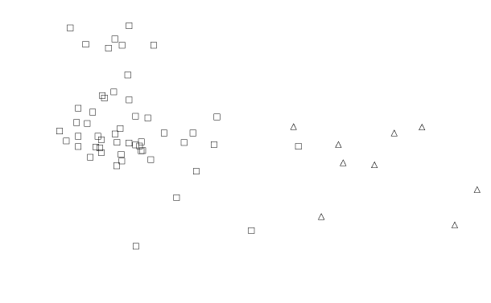
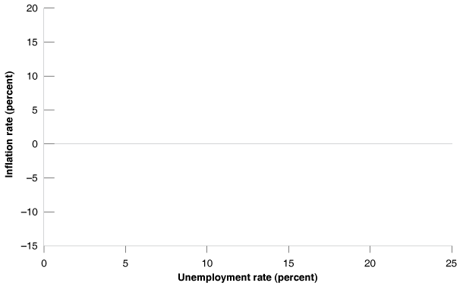
Inflation vs Unemployment in the United States, 1900 to 1960

Slide 5
Critics
Eight years later the original version of Phillips curve started to be criticized by Phelps and Friedman, both Nobel-prize-winner American economists, for not counting the possible effects of expected inflation in the equation. So, Friedman proposed a new, “expectations-augmented”, version of Phillips curve.

Slide 6
Economic Theory Behind P.C.
The actual source of the Phillips Curve is, infact, the aggregate supply relation, namely:
If we assume the following form for function F;
Then we get,

Slide 7
… which can also be rewritten as the basic form of P.C.
If we think of expectations as a function of the value from last year we can say that,
Where θ is between 0 and 1.

Slide 8
If θ = 0, model is called Conventional Phillips Curve.
If θ = 1, model is called Expectations-Augmented Phillips Curve.

Slide 9
Stagflation Years
In 1970s due to the price hikes in oil and change in the way wage-setters set their expectations, many countries experienced something called stagflation, in which both unemployment and inflation was positive and increasing at the same time, which wasn’t anything close to what Phillips had suggested.
Some say that during that time the θ value changed from 0 towards 1.

Slide 10
Here I checked the case for Netherlands
With the World Bank data from 1969 to 2016

Slide 11
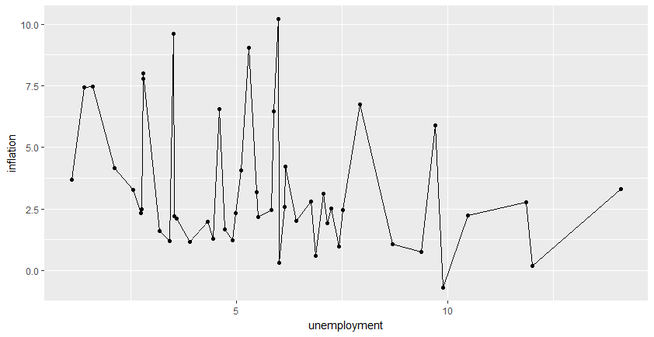
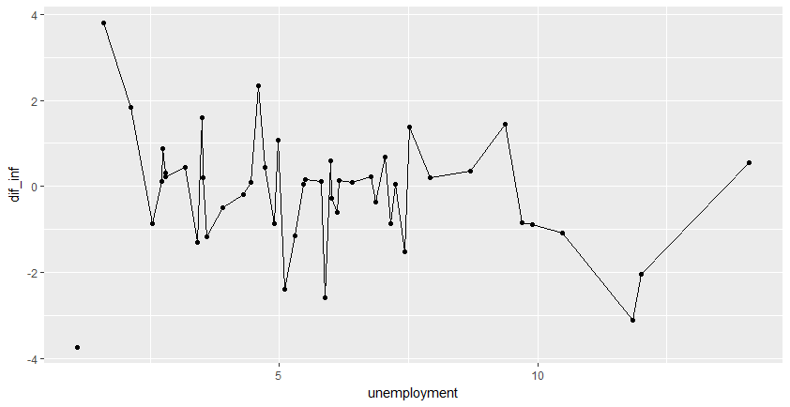
Graphical Description
Even here there seems to be a negative correlation.

Slide 12
Checking the Correlation
cor(data$inflation, data$unemployment, use="complete.obs")
- 0.3005086
cor(data$dif_inf, data$unemployment, use="complete.obs")
- 0.219441
Both variables seem to be correlated with unemployment, yet to learn about how significant the correlation is, we need to run regressions.

Slide 13
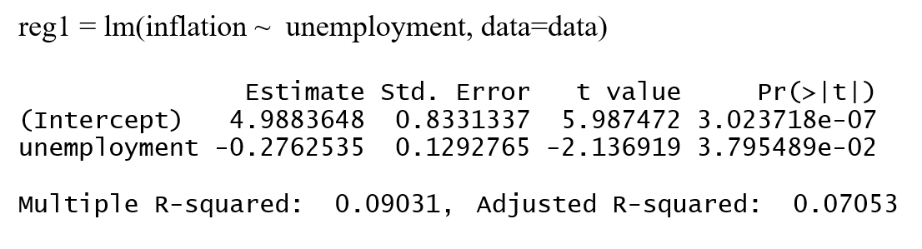
Conventional Phillips Curve
Coefficients show significant inverse relationship between unemployment and inflation, which validates the theory. Yet the R square is too low.

Slide 14
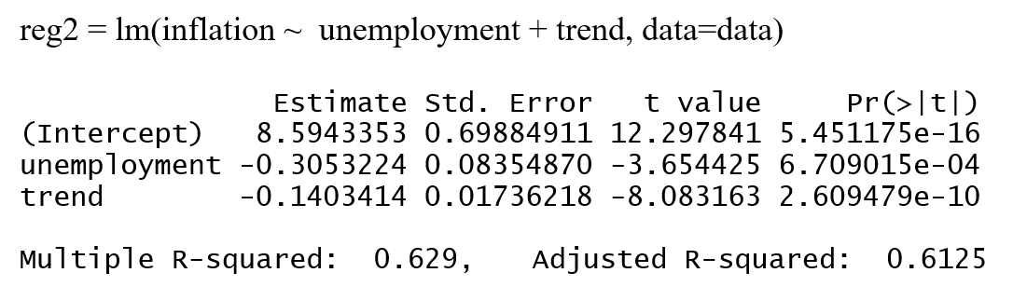
Conventional Phillips Curve cont’d
This time with a linear trend variable in the model we can say whether the trend is causing the correlation. And it turns out that both variables are significant and negatively correlated with inflation. Also R squared this time has risen sharply, confirming that the model has been improved.

Slide 15
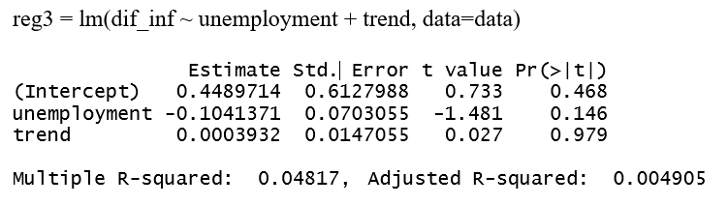
Expectations-Augmented Model
Here the dependent variable is the inflation difference between years, and not the inflation itself. And so there is no significant correlation. This model is not valid for Netherlands at all.

Slide 16
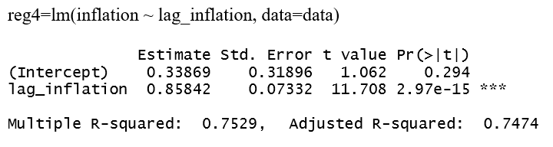
Expectations-Augmented Model cont’d
Here I made an autoregressive model of order 1 to see if there is any auto-correlation between past values. Apparently dependent variable (also the error terms) is auto-correlated with its past values, so strict exogenity assumption of OLS is violated, we cannot expect the coefficents to be unbiased.

Slide 17
Conclusion
Conventional Phillips Curve is valid in Netherlands, with a highly significant negative correlation between inflation and unemployment rate, whereas the Expectations-Augmented model is not.

